Slide 1

Homoscedasticity & Heteroscedasticity Analysis
Group 5 Presented

Slide 2
001: Definitions

Slide 3

DEFINATIONS
Homoscedasticity/ Homoskedasticity (Equal Variance) : The variance of the error terms (residuals) is constant across all values of the independent variable(s).
Heteroscedasticity / Heteroskedasticity (Unequal Variance) - The variance of the error terms (residuals) is not constant across values of the independent variable(s).
Target (y) - What we are trying to predict.
Feature (x) - Input variable that we use to predict the target.
Residual - The error between what the model predicts and the actual value:
Residual = Actual Value−Predicted Value

Slide 4
002: Visualizing Error Variance

Slide 5

Feature vs Target Plot (Simple Regression Only)
Plot X (feature) vs Y (target)
Homoscedastic: Scatter is evenly spread around trend line
Heteroscedastic: Scatter forms cone shape (spread increases with X)

Slide 6
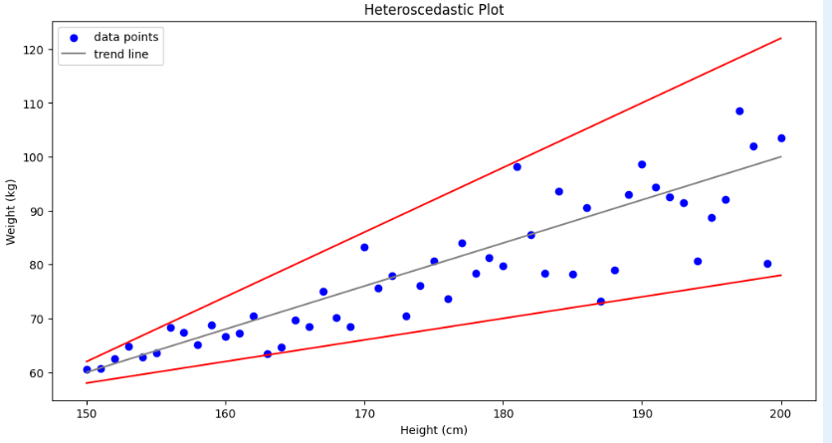
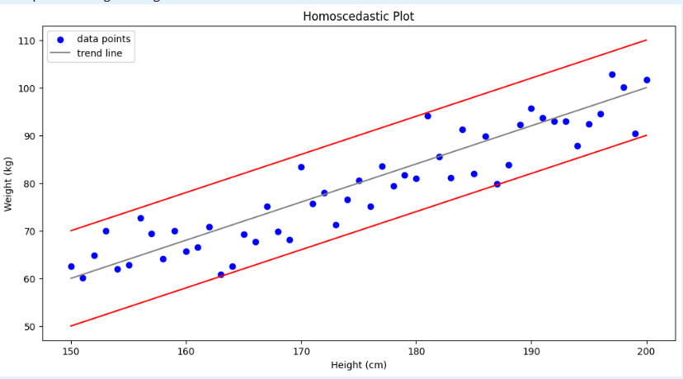
Homoscedastic Plot
Heteroscedastic Plot

Slide 7
Residual Plot(Simple/Multiple Regression))
Plot predicted values vs residuals
Homoscedastic: Residuals form horizontal band
Heteroscedastic: Residuals fan out or show non-constant pattern

Slide 8
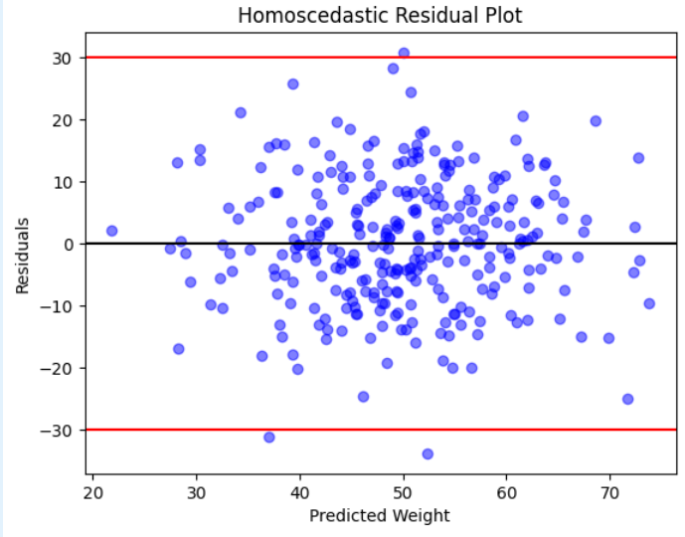
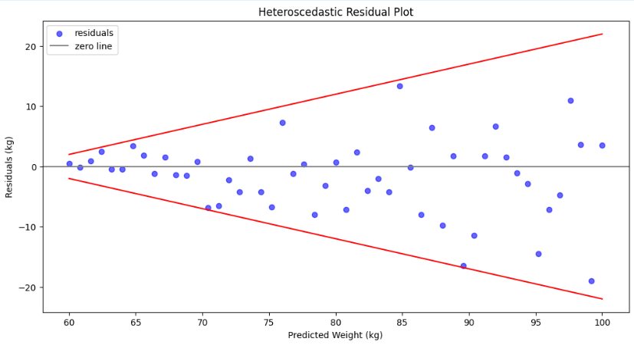
Homoscedastic/ Even Plot
Heteroscedastic/ cone-shaped Plot

Slide 9
003: Statistical Tests for Homoscedasticity

Slide 10
Goldfeld-Quandt Test
Split data into two groups
Compute Mean Squared Error (MSE) for each
Test statistic = MSE₂ / MSE₁ → compare to F-distribution
Hypotheses:
H₀: Residuals have equal variance
H₁: Residuals do not have equal variance

Slide 11
Breusch-Pagan Test
Calculate residuals from the regression model.
Square the residuals to measure their size.
Regress squared residuals on independent variables.
Calculate the test statistic (based on the Lagrange Multiplier approach) and derive a p-value.
Hypotheses:
H₀: Residuals have equal variance (homoscedasticity)
H₁: Residuals do not have equal variance (heteroscedasticity).

Slide 12
Test Results (Homoscedastic Cases)
Goldfeld-Quandt: p = 0.701 > 0.05 → fail to reject H₀ implying Homoscedasticity
Breusch-Pagan: p = 0.659 > 0.05 → fail to reject H₀ implying homoscedasticity

Slide 13
Breusch-Pagan Test
Goldfeld-Quandtp ≈ 1.22e-9 → reject H₀ (heteroscedasticity)
Breusch-Pagan: p = 0.014 → reject H₀ (heteroscedasticity)

Slide 14

Thank you

